Slide 1

LABOR SYSTEM
HR USER GUIDE

Slide 2
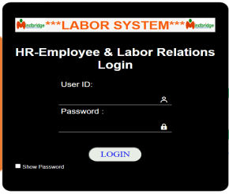
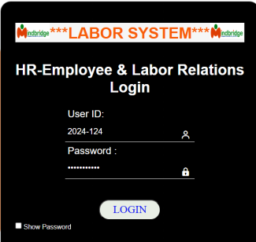
LABOR SYSTEM -HR USER GUIDE
1. Logging into Labor System
Once the user(s) have received the User ID & Password details, click / type the given URL link provided and you will be taken to the log in page. You may request your User ID and Password to your assign Labor Associate.
2. On the Login page, TYPE in your User ID and Password that you received from head office -Labor Associate and click the LOGIN button. After the successful login, the USER(s) will directly be lead to the Labor Systems page: Data Entry, Uploading & Inquiries.

Slide 3
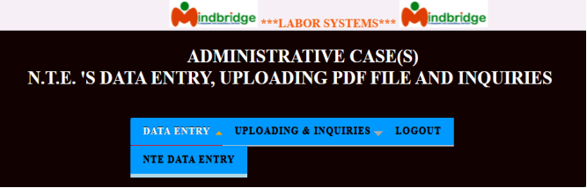
LABOR SYSTEM -HR USER GUIDE
Contents Tree
When you open a Labor Systems (LS), a contents tree will be displayed to the left of the main screen.
The Contents tree will include a list of all Input statements that are available to you in this Data Entry Module and Reports & Inquiries.
The main window has the menu bar with the following options: DATA ENTRY, UPLOADING & INQUIRIES and LOGOUT.
These will be defined by the HR Labor Advisor, according to the information they require. The items listed in the Contents Tree will vary, since the HR Labor Advisor will select the appropriate content for each Data Entry Module that they create. Contents tree access assign only per user view and it will depend to the HR Labor Advisor.
To expand and collapse the hierarchy of the Labor Systems categories within the contents tree click on the Expand and Collapse icon respectively. Input statements at the bottom node in a hierarchy are indicated by the icon.
* Data Entry Section - The “DATA ENTRY” section allows the user to entry the data into each field. Use the Tab or manually use the mouse to move on to the next field to enter the missing data.
* Accessing Data Entry - To access the Data Entry section, go to the main window. Click on DATA ENTRY menu bar, then choose the criteria appears as shown below.The Labor Systems (LS) user(s) can view only the criteria base on their user LOGIN.
On selecting the “DATA ENTRY” option on the menu-bar of the main window, a pull-down menu is displayed the N.T.E DATA ENTRY. as shown in the window.

Slide 4
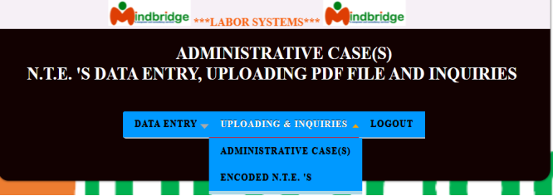
LABOR SYSTEM -HR USER GUIDE
Uploading & Inquiries Section - The UPLOADING & INQUIRIES section allows the user to upload pdf file image and inquire the data or access details of the subject person involved / employee.
* Accessing Uploading & Inquiries - To access the UPLOADING & INQUIRIES section, go to the main window. Click on UPLOADING & INQUIRIES menu bar, then choose the criteria appears as shown below.

Slide 5
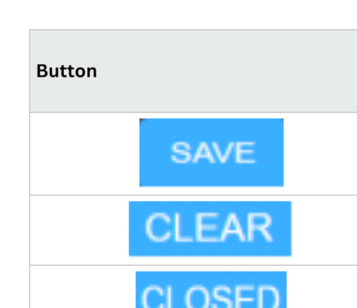
LABOR SYSTEM -HR USER GUIDE
Buttons:

Slide 6
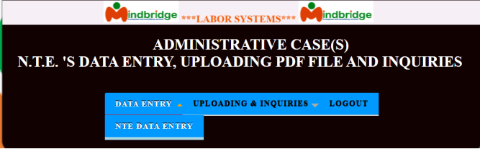
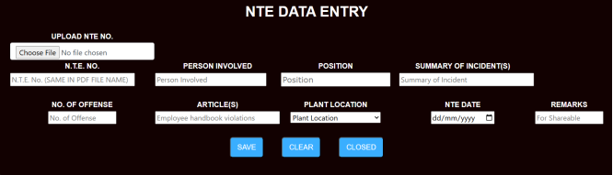
LABOR SYSTEM -HR USER GUIDE
On selecting the “NTE DATA ENTRY” option, the Information window is displayed. Given below is a sample display of the ADMINISTRATIVE (CASE(S) N.T.E.’s DATA ENTRY control information window.
All data fields in the ADMINISTRATIVE (CASE(S) N.T.E DATA ENTRY must be filled. Enter data into each field. Use the Tab or Enter key to move to the next field.
The user(s) must fill in all the necessary and required fields. All information are found on the submitted documents.
NTE Case number must be uniqure at all times. Please refer to your case number monitoring.
.

Slide 7

LABOR SYSTEM -HR USER GUIDE
REMINDER
In “Remarks” field, type the word “Share or Shareable” .
only if the case is shareable charges so that the entire case will go to the assign Labor Associate who handle the shareable cases.

Slide 8
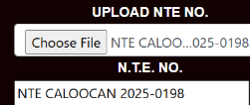
LABOR SYSTEM -HR USER GUIDE
In uploading NTE image file, click “Choose FIle”, then, find the image you want to to upload.

Slide 9
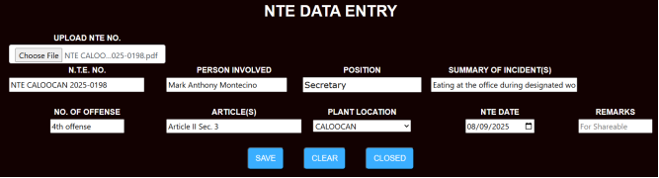
LABOR SYSTEM -HR USER GUIDE
Reminder: The file name of your image pdf must be the same as your NTE No.
IMPORTANT: CHECK ALL THE DETAILS OF INFORMATION BEFORE SAVING

Slide 10

LABOR SYSTEM -HR USER GUIDE
On selecting the “ADMINISTRATIVE CASE(S)” option, the Information window is displayed. Given next window below is a sample display of the ADMINISTRATIVE CASE(S) control information window.

Slide 11
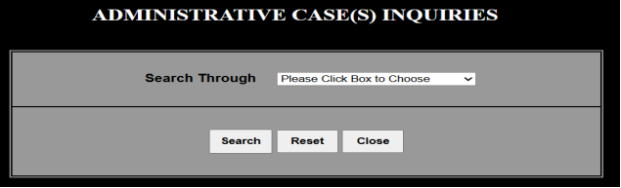
LABOR SYSTEM -HR USER GUIDE
The Labor user(s) will press the drop down box to choose which Search through to use in uploading & inquiries. The LS user(s) had an option to use Search Through: BY PERSON INVOLVED or BY PLANT LOCATION. Given next window is a sample display control information window.

Slide 12
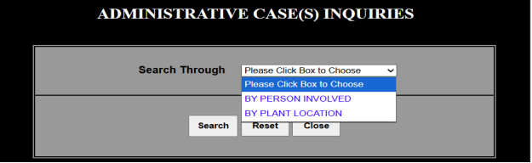
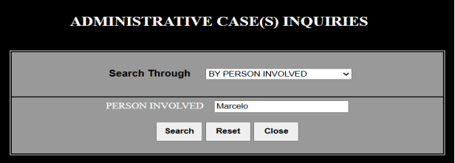
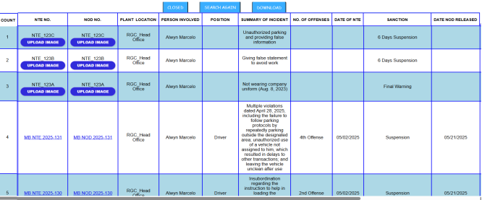
LABOR SYSTEM -HR USER GUIDE
The Labor user(s) will press the drop down box to choose which Search through to use in uploading & inquiries. The LS user(s) had an option to use Search Through: BY PERSON INVOLVED or BY PLANT LOCATION. Given next window is a sample display control information window.
In searching through by person involved “Marcelo”, this will display all the person with subject above related. See the next display window:
In this window, the user(s) are allowed to “UPLOAD IMAGE”.
In uploading NTE or NOD, Ensure the PDF image filename matches the actual NTE NO. or NOD NO.. The control number displayed on the screen may not be the actual, correct NTE/NOD number. If the displayed number is incorrect, click on the upload button to edit and input the correct, accurate NTE or NOD as show below;

Slide 13
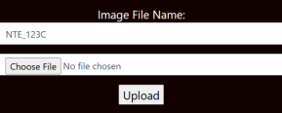
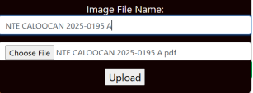

LABOR SYSTEM -HR USER GUIDE
In uploading NTE or NOD, Ensure the PDF image filename matches the actual NTE NO. or NOD NO.. The control number displayed on the screen may not be the actual, correct NTE/NOD number. If the displayed number is incorrect, click on the upload button to edit and input the correct, accurate NTE or NOD as show below;
Upon clicking upload, the system automatically attaches a Document into the corresponding control number as shown below;

Slide 14
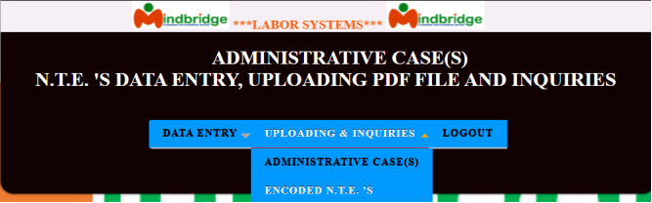
LABOR SYSTEM -HR USER GUIDE
On selecting the “ENCODED N.T.E.’S” option, the information window is displayed depends on the user access location. Given next window below is a sample display of the ENCODED N.T.E.’S control information window.

Slide 15
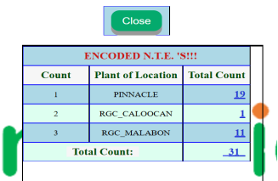
LABOR SYSTEM -HR USER GUIDE
Click the total count display per location if the user(s) want to display the encoded NTE’s as show below;

Slide 16
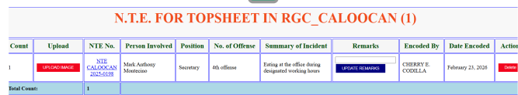
LABOR SYSTEM -HR USER GUIDE
This screen show has the option of the following listed below;
1. UPLOAD IMAGE = Allowing user(s) to upload, review, and re-upload PDF image files, especially when files are missing, illegible, or insufficient.
2. UPDATE REMARKS = Applicable to shareable cases. In “Remarks” field, type the word “Share or Shareable”, if a case is classified as involving shareable charges , and it is assigned to a specific Labor Associate handling such cases, the entire case, including its documentation and resolution, will be managed by that designated personnel.
3. Delete = Allowing authorized user(s) to delete cases—specifically restricting them to deleting only cases they own or created—is a best practice for maintaining data integrity and security.

Slide 17
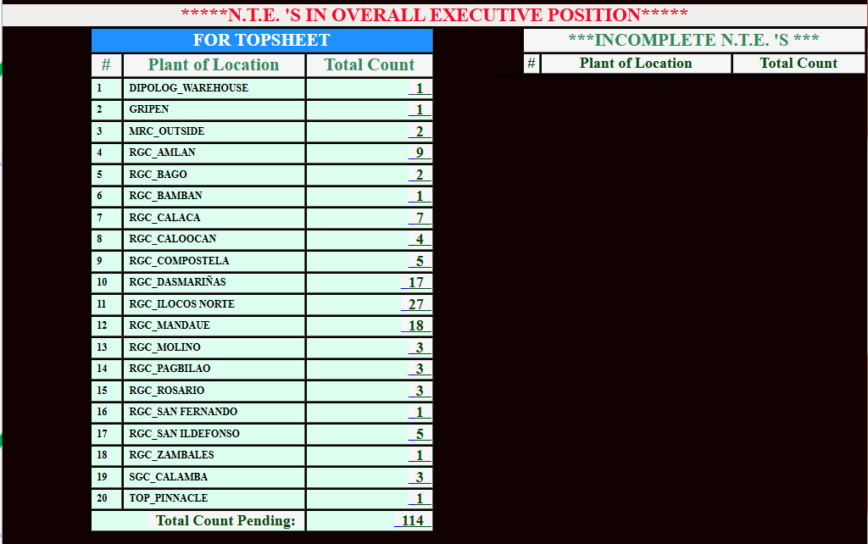
LABOR SYSTEM -HR USER GUIDE
Once you succeed in uploading your NTE for review. It will appear in your assigned Labor Associate’s dashboard for TOP SHEET.
However, if the Labor Associate finds that there is a concern or error in your case for review, it will be transferred to the Incomplete NTE section for your checking and remarks.
Once you corrected the concer, you may transfer the case from Incomplete to For review at once.

Slide 18
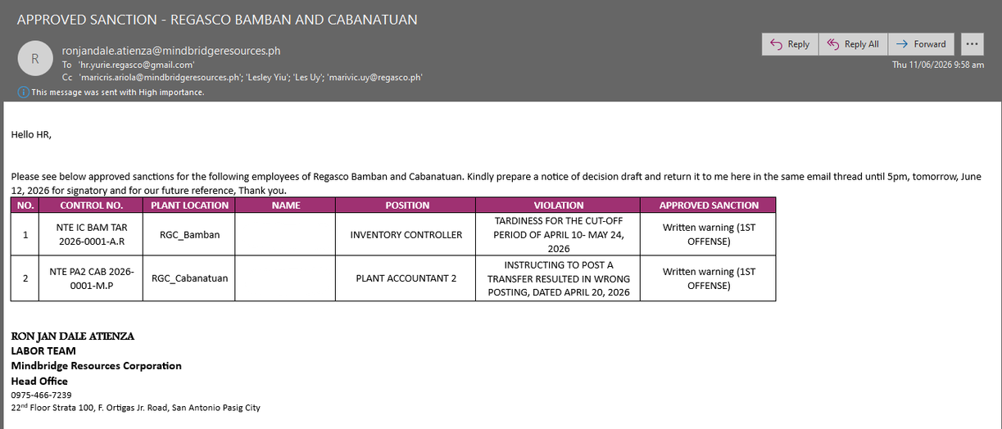
LABOR SYSTEM -HR USER GUIDE
Once your assigned labor completed the review. You will receive an email of APPROVED SANCTION as basis of your Notice of Decision Draft.
Just email the Notice of Decision Drafts in the same thread of approved sanction for the final review of Labor Associates.
Once done, you will receive the NOD for serving via email.
Once served, you may now proceed with uploading the received notice of decision to finally close the case in our labor system.

